Slide 1
(BI) Analyst Capstone Project

Slide 2
Introduction
Business Scenario
As a BI Analyst in a leading retail chain that operates globally, renowned for its diverse product offerings and commitment to customer satisfaction
Tasks
Conduct a comprehensive analysis of the sales performance of the retail chain across different regions and time periods

Slide 3
Methodology
Retail Sales Data
Consisted 3 files, daily sales data, product hierarchy, stores locations
Steps Taken
Data Cleaning and Analysis
Data Querying and Analysis
Chart Creation and Regression Analysis
Data Visualization

Slide 4
RESULTS

Slide 5
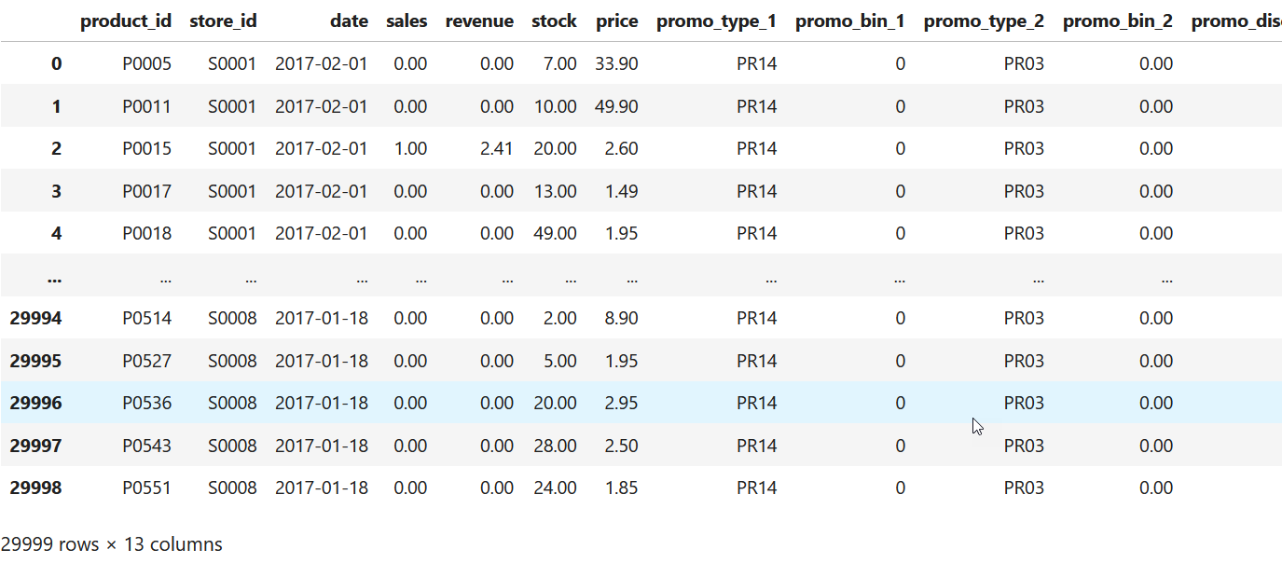
Module 1 Lesson 1: Data Cleaning and Preparation
Screenshot of the cleaned and prepared dataset
The cleaned dataset enables analysis much easier and accurate

Slide 6
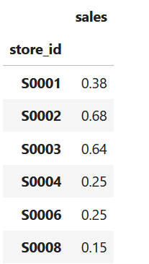
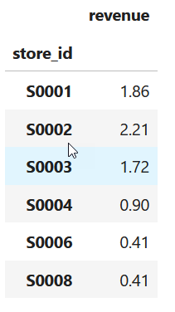
Module 1 Lesson 2: Basic Analysis Using Pivot Tables
Sales Data Analysis
This information can guide decisions about product development, marketing strategies, and pricing.
Sales by City Analysis
It can reveal regional preferences and market penetration, helping businesses tailor their strategies to different locations

Slide 7
Module 2 Lesson 1: Data Querying Using PostgreSQL
A written SQL query to check whether data is populated in the table
SELECT COUNT(*) FROM sales_table;
A written SQL query that performs the sales performance analysis
SELECT store_id, AVG(sales) as average_sales
FROM sales_table
GROUP BY store_id;

Slide 8
Module 2 Lesson 2: Data Analysis Using PostgreSQL
Creation of data cubes with ROLLUP
SELECT store_id, product_id, SUM(sales) as total_sales
FROM sales_table
GROUP BY ROLLUP(store_id, product_id);
Summarizing data along hierarchies
SELECT city, store_name, SUM(sales) as total_sales
FROM sales_table
GROUP BY ROLLUP(city, store_name);

Slide 9
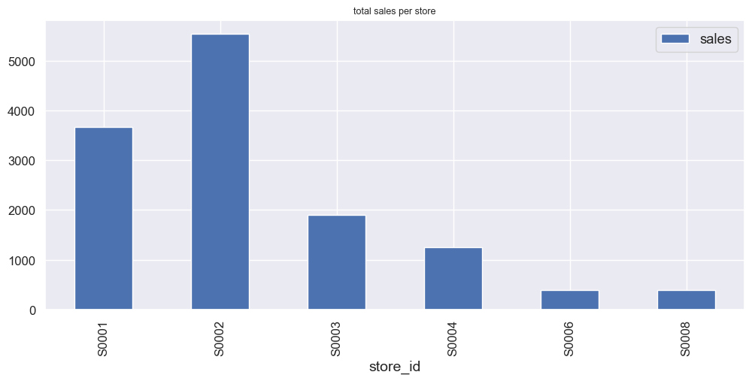
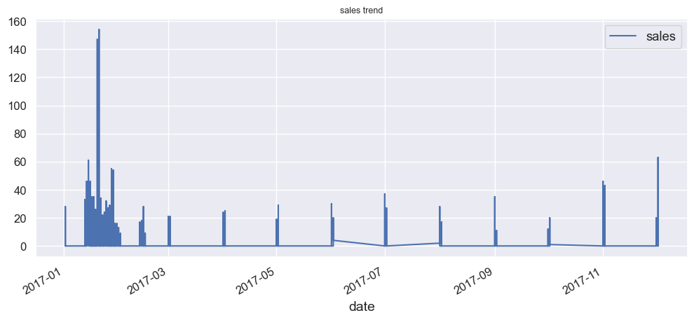
Module 3 Lesson 1: Data Visualization Using MS Excel
Line chart can be particularly useful for forecasting future values or understanding the impact of specific events on your data. Bar plot is used to compare different groups or to track changes over time.

Slide 10
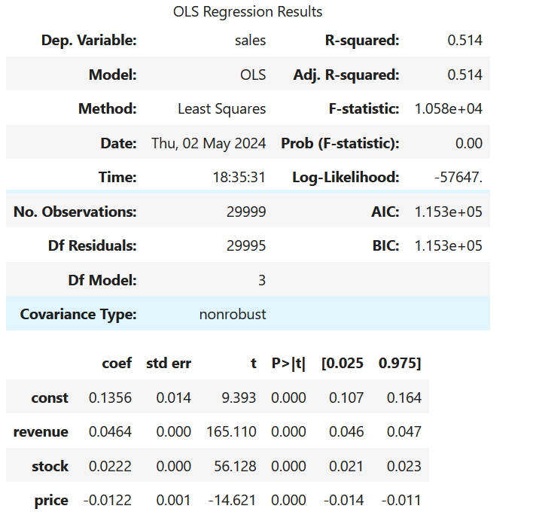
Module 3 Lesson 2: Statistical Analysis
R squared at 0.51, it means that 51% of the variability in the outcome data can be explained by the model’s inputs.
Independent variables of revenue, stock and price is significant in this prediction

Slide 11
Module 4 Lesson 1: Basic Tableau Visualizations
Scatter plots are used to display the relationship between two numerical variables. They can help identify correlations, trends, and outliers in the data
Packed bubbles charts are useful for visualizing hierarchical data and part-to-whole relationships. They can help highlight the relative importance or proportion of different categories.

Slide 12
Module 4 Lesson 2: Advanced Visualizations Using Tableau
In a Tableau dashboard, these visualizations can be combined and interacted with, allowing decision-makers to explore the data from multiple angles and drill down into areas of interest. The ability to filter and drill down into the data makes the insights gained from these visualizations even more powerful.

Slide 13
Discussion

Slide 14
Summary

Slide 15
Thanks!
ANY QUESTIONS?
You can find me at:
@username user@mail.me

